Slide 1
Okay, this is totally random and you have absolutely no obligation to do this but I just thought the idea might be really FUN!
A few years ago you told me that your swim team only called you John Batty. Not John. Not Mr. Batty. Or Coach Batty. It was always John Batty.
Then there is the whole John Batty weekend thing. I mean, you really have a lot of name recognition on the internet! I think you might benefit from that in your business! Another time we talked you said you were interested in having the photo shoot be fun, as if I were shooting for Pixar.
As I was working with your group of employees, I kept thinking this group of people reminded me of something … but what was it? … Then it occurred to me …

Slide 2


Slide 3
I mean … what if …

Slide 4
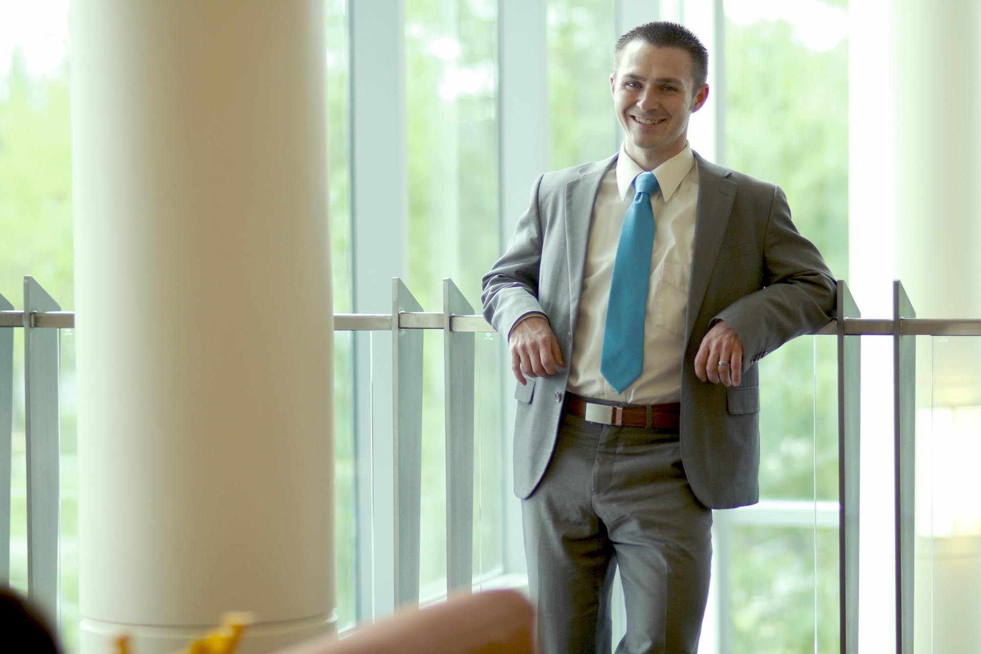

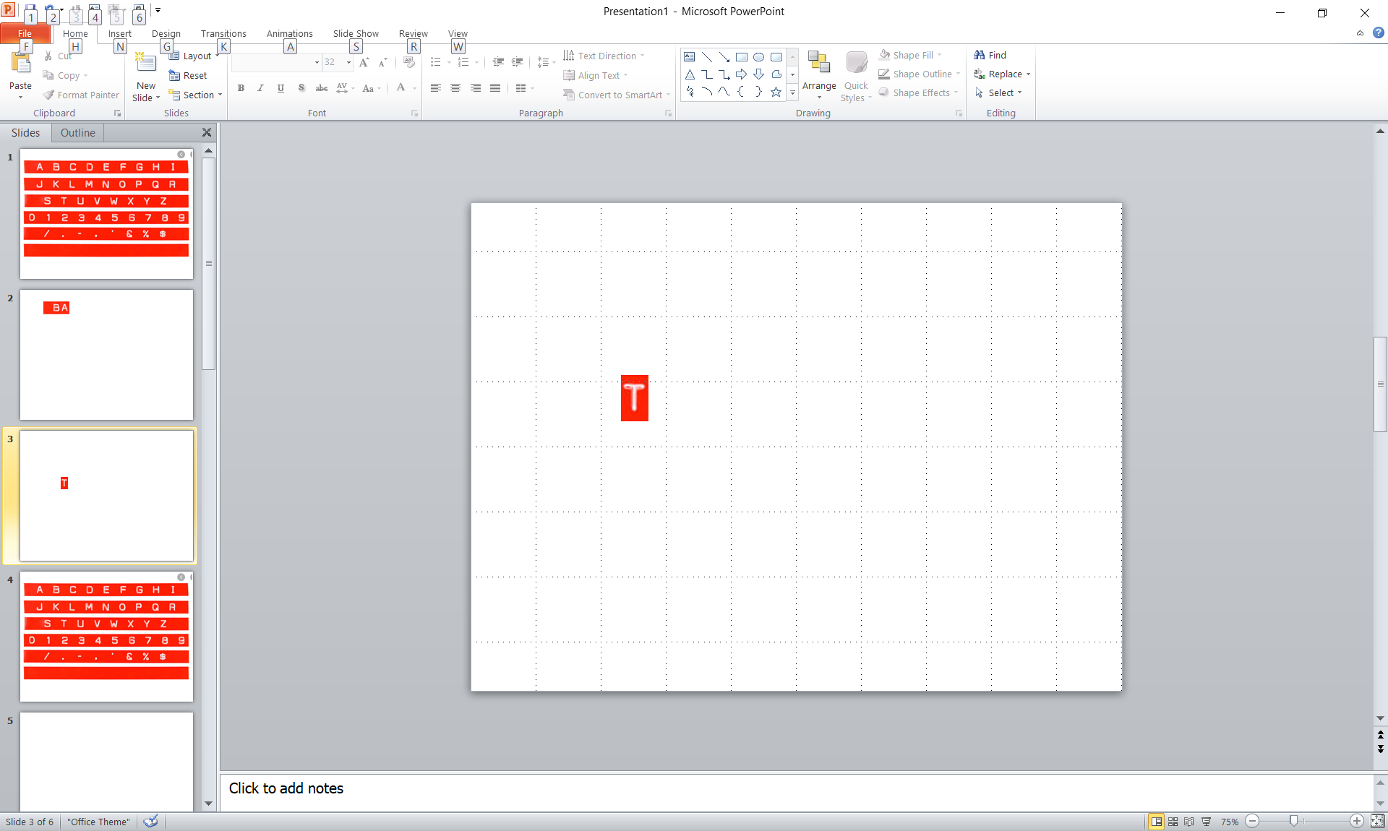
JOHN BATTY – BRAIN SQUAD

Slide 5


Slide 6
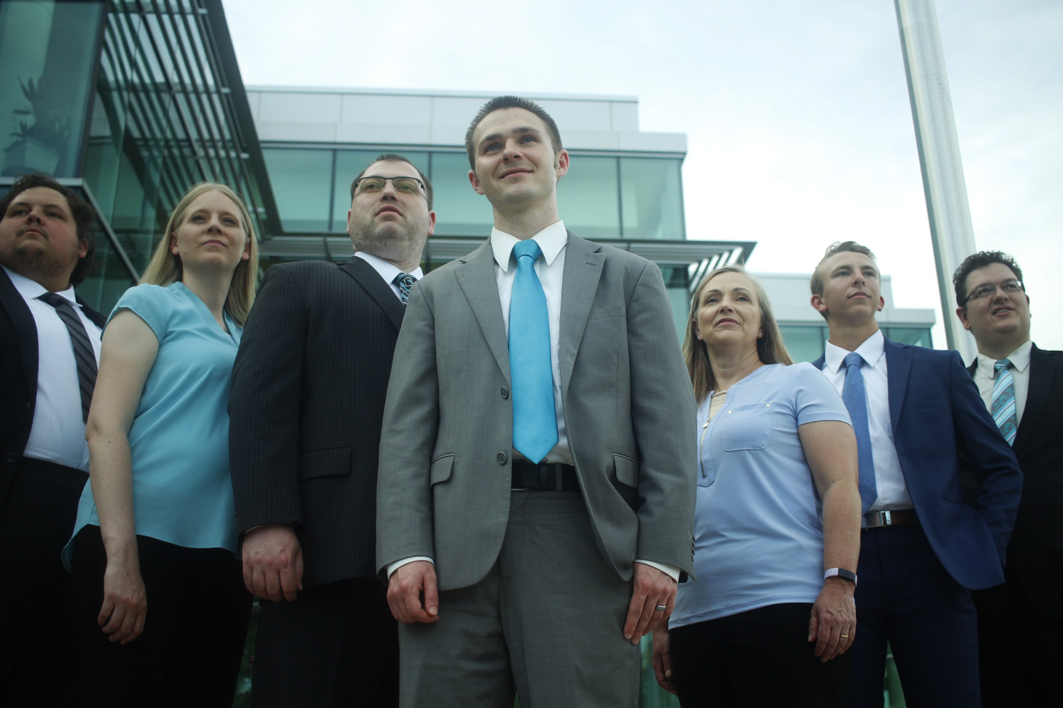
JOHN BATTY – BRAIN SQUAD

Slide 7


Slide 8


Slide 9


